Slide 1
Physiological Role of Stress

Slide 2
Learning Objectives
Describe the physiological mechanisms of chronic and acute stress responses
Explain how physiological changes associated with stress can are linked to appetite, fat mobilization and diabetes
Understand the relationship between endogenous mediators of stress and commonly prescribed glucocorticoid medications
Evaluate the role of weight stigma and chronic stress in obesity
Describe the links between adverse childhood events on the risk of obesity

Slide 3
Inducers of Stress

Slide 4
What is stress?
Take a few minutes reflecting on things that cause stress, and how you respond to it?

Slide 5
Some Common Sources of Stress
Intrinsic
Extrinsic
Sleep quality
Self-actualization
Chronic Illness
Social isolation
Neighborhood safety
Conflict
Work demands
Food insecurity
Lack of social support

Slide 6
Effects of adverse childhood experiences on obesity
Some traumatic events
Poor parenting
Divorce
Poor mental health
Chronic illnesses in family
Domestic violence
Child abuse

Slide 7
Physiological Responses to Stress

Slide 8
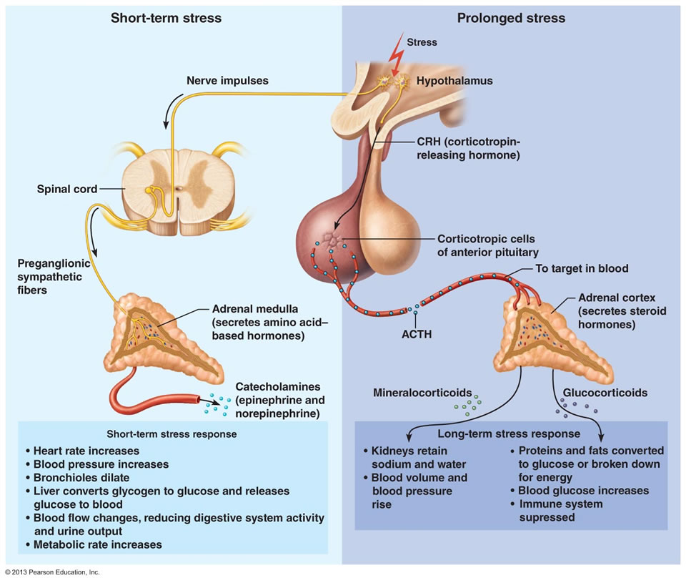
Adrenaline and Cortisol are Stress Hormones
Adrenaline
Blood presure/heart rate
Bronchiodilation
Reduced digestion
Cortisol
Appetite
Increased blood glucose
Proteins/Fat broken down
Notes:
Talk about initial effects of stress, diverting energy away from food seeking behavior
Ongoing stressful events need more food

Slide 9
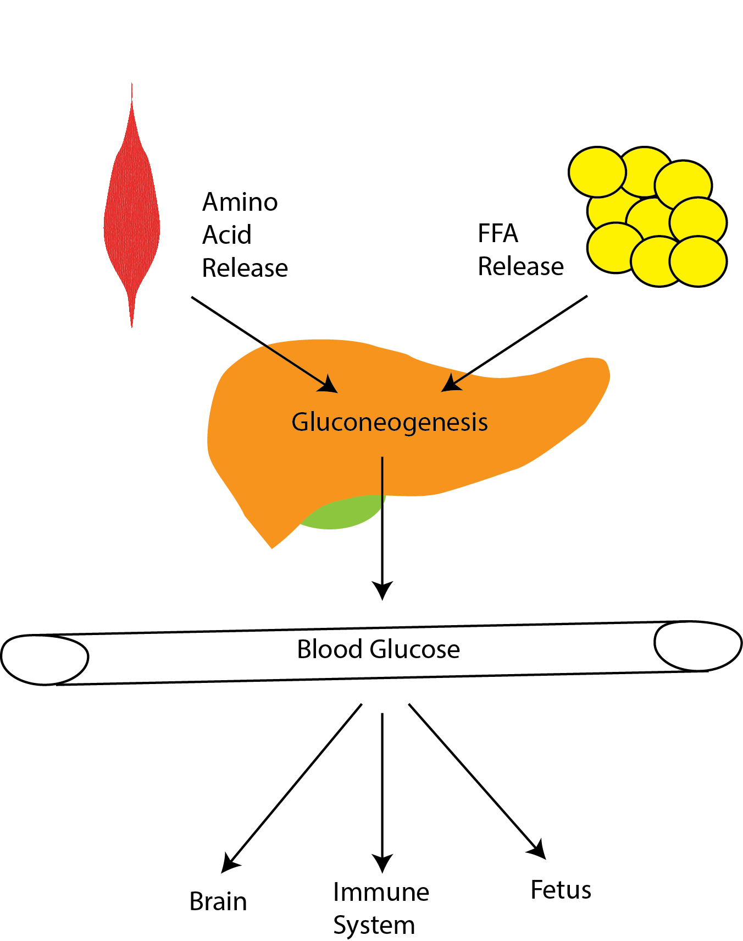
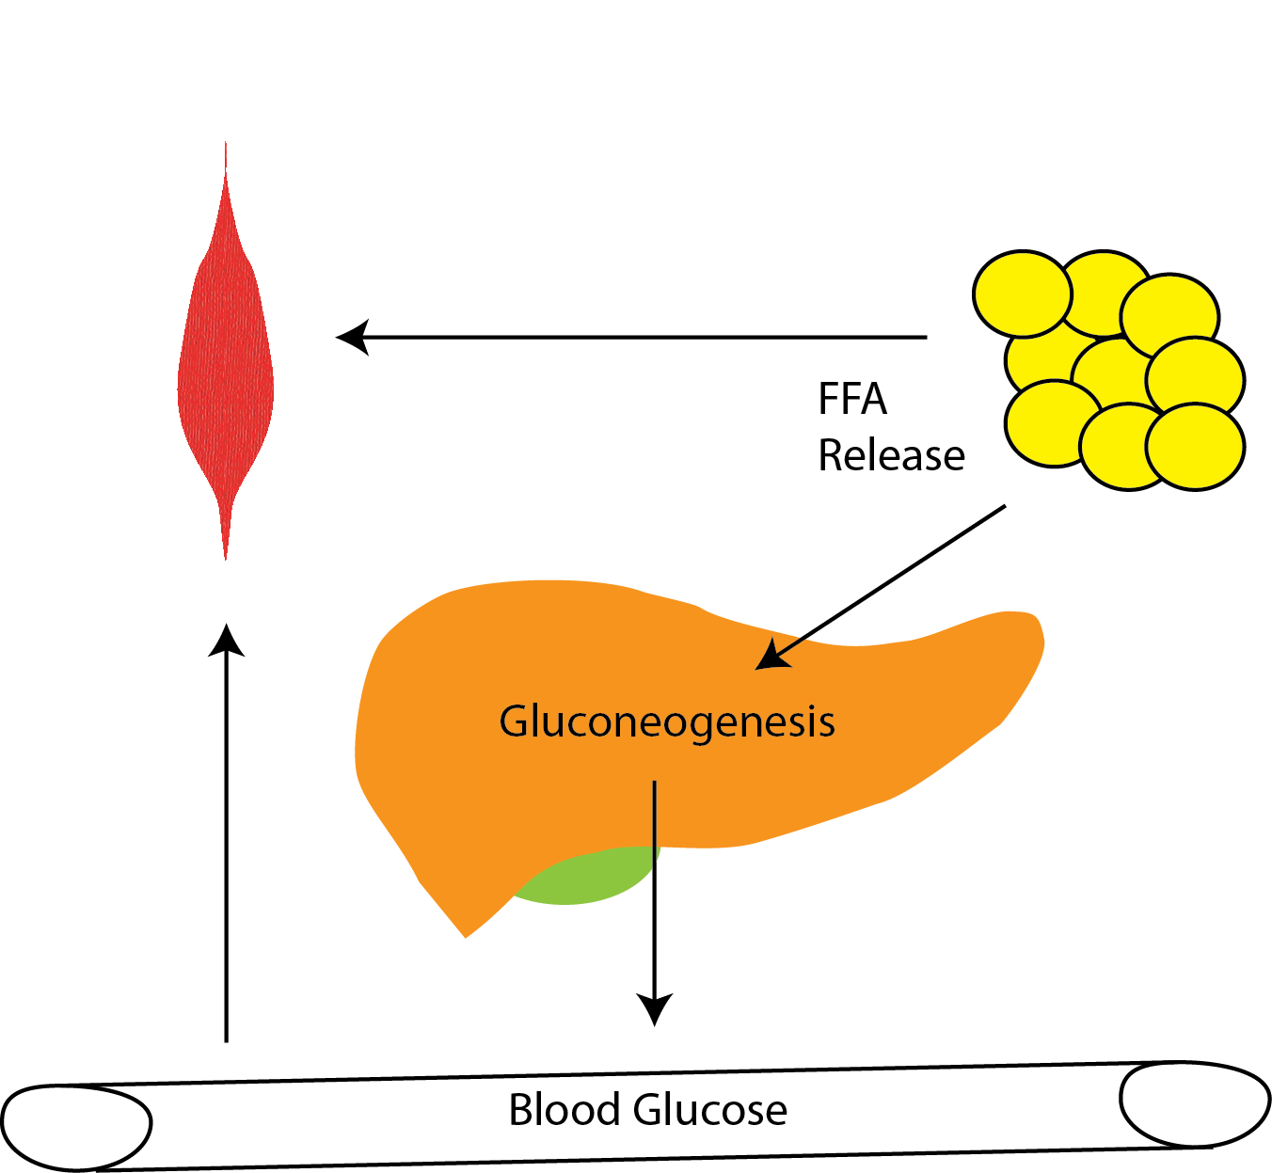
Metabolic Roles of Stress Hormones
Cortisol
Epinephrine
Notes:
Discuss similarities and differences between cortisol and epinephrine.
Spend some time, talking about why these differences exist

Slide 10
Physiological effects of cortisol
Increased blood glucose
Muscle breakdown (weakness)
Fat redistribution
Increased liver fat
Increased sensitivity to adrenaline
Increased appetite

Slide 11
Cortisol and Eating

Slide 12
Effects of Chronic Stress on Appetite
Effects on energy expenditure mediated by reductions in muscle
Stress or prescribed glucocorticoids have a strong hyperphagic effect
Response to injected Corticotropin Releasing Hormone (CRH) in humans

Slide 13
Some Variation in Stress-Eating Responses
Men: 33.9% ate more food
Women: 55% ate more food
Notes:
Females report hyperphagia for sweets and chocolate
Dieters were more likely to report hyperphagia for breads

Slide 14
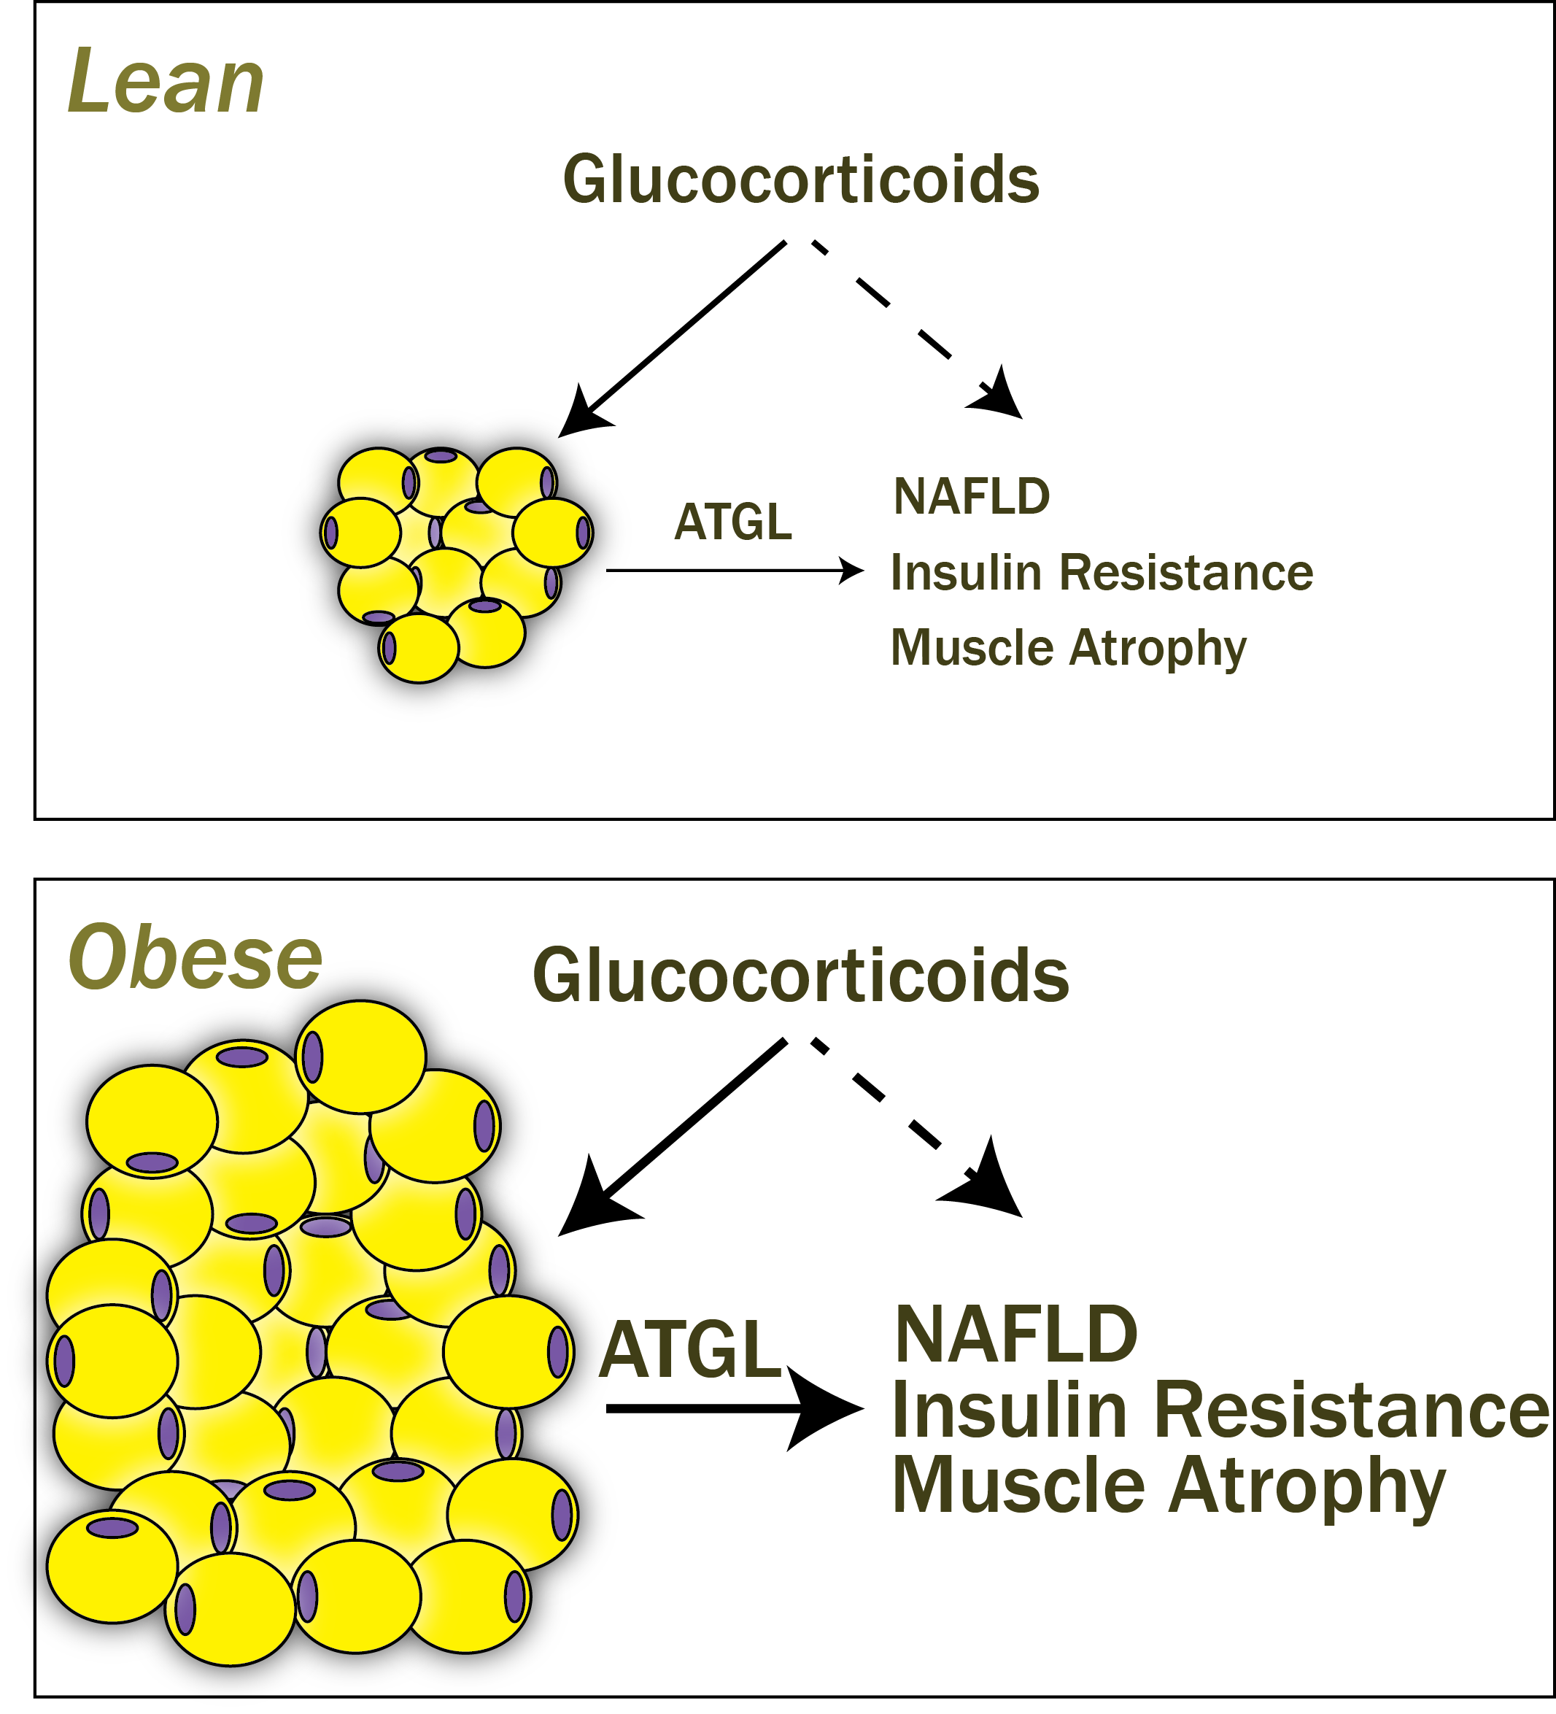
Associations between Stress and Weight Stigma
Cycle of obesity/stigma/stress
Increased adiposity makes us more sensitive to cortisol
Think of some strategies for breaking this cycle
Weight loss
Exercise
Self-perception of body weight
Acceptance interventions
Notes:
COBWEBS model
Acceptance interventions such as healthy at any size Exercise reduces stress, but stigma is associated with exercise avoidance

Slide 15
Learning Objectives
Describe the physiological mechanisms of chronic and acute stress responses
Explain how physiological changes associated with stress can are linked to appetite, fat mobilization and diabetes
Understand the relationship between endogenous mediators of stress and commonly prescribed glucocorticoid medications
Evaluate the role of weight stigma and chronic stress in obesity
Describe the links between adverse childhood events on the risk of obesity

Slide 16
Exam Review
Format is:
27 Multiple Choice worth 2 points each
7 Short Answer Questions worth 32 points total

Slide 17
On what basis do twin studies help us identify V_{g}?
Identical twins always have the same environment
Fraternal twins share no genetic factors
Identical twins when separated can have shared genetics but may not have a shared environment
Twin studies do not help determine V_{g}
Notes:
C

Slide 18
Genetic vs Shared Environment
Familial (V_{e} + V_{g})
Traits are shared by relatives for any reason
Genetic (V_{g})
Similarities arise from shared genotypes
Activity: List some aspects of obesity that you think would be heritable vs shared environment vs non-heritable.

Slide 19
Which of these is least likely to be a component of familial heredity of obesity?
Shared genotypes
Shared cultural norms
Medication use
Local environment
Notes:
C

Slide 20
According to the data presented in class, which of these foods is associated with the lowest risk of weight gain?
White rice
100% orange juice
Baked potato
Walnuts
Notes:
D

Slide 21
What is a limitation of using Body Mass Index?
No standardized cutoffs
Easy to determine
Uncorrelated with body fat levels
Indirect measurement of adiposity
Notes:
D

Slide 22
Rank these adiposity assessment techniques in order of how much time they would take to perform one measurement
BMI > Skin-Fold Thickness > DEXA
Skin-Fold Thickness > DEXA > Waist Circumference
DEXA > Waist Circumference > BMI
BIA > DEXA > Skin-Fold Thickness

Slide 23
Which component of energy expenditure is affected most by the amount of protein eaten?
BMR (Basal Metabolic Rate)
TEF (Thermic Effect of Food)
SMR (Sleeping Metabolic Rate)
EAT (Exercise Active Thermogenesis)

Slide 24
For which sedentary behavior is there the most consistent evidence of an association with obesity?
Reading
Listening to music
Watching TV
Checking Twitter
Notes:
C

Slide 25
Adaptive Changes with Weight Loss

Slide 26
Which of the following is not an appetite suppressing hormone?
Ghrelin
Peptide YY (PYY)
GLP-1
Insulin
Notes:
A

Slide 27
In the sleep restriction trials discussed in class, short term changes in children’s sleep have not resulted in:
Increased preference for protein
Increased preference for carbohydrates
Changes in appetite hormones
Changes in weight
Notes:
A

Slide 28
Two students ingest exactly the same number of calories, how is it possible that their energy intake differs?
Changes in basal metabolic rate can affect energy intake.
Differences in the microbiome could affect nutrient extraction efficiency.
One person could be consuming those calories as liquids rather than solids.
Their energy intake would be equal.
Notes:
B

Slide 29
Some genes associated with obesity

Slide 30
Which of these behaviors would best indicate an individual is highly food responsive?
They cannot resist taking a few M&Ms when they walk by a candy bowl
They eat more during times when they’re sad
They eat less during times when they’re sad
They enjoy cooking for their friends and family
Notes:
A

Slide 31
Which of the following is the most modifiable by activity levels?
Thermic Effect of Food (TEF)
Basal Metabolic Rate (BMR)
Non-Exercise Active Thermogenesis (NEAT)
Total Daily Energy Expenditure (TDEE)
Notes:
C

Slide 32
Which macronutrient has the highest Atwater factor (kcal/g)
Lipids
Carbohydrates
Protein
Fiber
Vitamins

Slide 33
Short Answer Study Guide Questions
Describe one smartphone app that may contribute to obesity. Explain why you chose this app. Describe one smartphone all that may reduce risk for obesity. Explain why you chose this app.
Identify and describe two potential reasons why the introduction of a grocery store to a neighborhood does not appear to improve residents’ dietary intake.
What is the major component of energy expenditure in most people? How is this affected by sex, age and lean mass? Two people are the exact same sex, dimensions and age, but one has recently lost 40 lbs. Do they have the same metabolic rate, or would we expect one to be higher? Why?

